Slide 1

Department of Collegiate and Technical Education
Artificial Intelligence and Machine Learning
( V Semester)
WEEK-6 Session-7
Implement Python Program to Build and Evaluate Regression model
Course Code: 20CS51I
Computer Science and Engineering

Slide 2
What we learned in previous session?
Introduction of Crop Production dataset
Import the Required Libraries
Import Dataset and Understand It
Data Pre-processing
Exploratory Data Analysis
Preparing the Data for Training the Model
Splitting the Data into Training and Testing sets
Computer Science & Engineering –20CS51I

Slide 3
Table of Contents of Session 7
Introduction of Boston Housing Price Dataset
Import the Required Libraries
Import Dataset and Understand It
Data Pre-processing
Exploratory Data Analysis
Preparing the Data for Training the Model
Splitting the Data into Training and Testing sets
Training and Testing the Model
Model Evaluation
Conclusion
Computer Science & Engineering –20CS51I

Slide 4
Introduction of Boston Housing Price Dataset
Boston House Prices Dataset was collected in 1978 and has 506 entries with 14 attributes or features for homes from various suburbs in Boston.
Boston Housing Dataset Attribute Information (in order)
CRIM: Per capita crime rate by town
ZN: Proportion of residential land zoned for lots over 25,000 sq. ft
INDUS: Proportion of non-retail business acres per town
CHAS: Charles River dummy variable (= 1 if tract bounds river; 0 otherwise)
NOX: Nitric oxide concentration (parts per 10 million)
RM: Average number of rooms per dwelling
AGE: Proportion of owner-occupied units built prior to 1940
DIS: Weighted distances to five Boston employment centers
RAD: Index of accessibility to radial highways
TAX: Full-value property tax rate per $10,000
PTRATIO: Pupil-teacher ratio by town
B: 1000(Bk — 0.63)², where Bk is the proportion of [people of African American descent] by town
LSTAT: Percentage of lower status of the population
MEDV: Median value of owner-occupied homes in $1000s
Computer Science & Engineering –20CS51I

Slide 5
Introduction of Boston Housing Price Dataset
.
Access Boston Housing Price Dataset from the scikit-learn library.
Computer Science & Engineering –20CS51I

Slide 6
Import the Required Libraries
import numpy as np
import matplotlib.pyplot as plt
import pandas as pd
import seaborn as sns
%matplotlib inline
Computer Science & Engineering –20CS51I

Slide 7
Import Dataset and Understand It
Import Dataset
from sklearn.datasets import load_boston
boston_dataset = load_boston()
Print the value of the boston_dataset to understand what it contains.
print(boston_dataset.keys())
#output
dict_keys(['data', 'target', 'feature_names', 'DESCR'])
Computer Science & Engineering –20CS51I

Slide 8
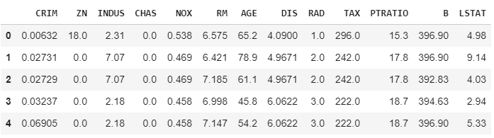
Import Dataset and Understand It
Load the data into a pandas dataframe using pd.DataFrame. and then print the first 5 rows of the data using head()
boston = pd.DataFrame(boston_dataset.data, columns=boston_dataset.feature_names)
boston.head()
#output
Computer Science & Engineering –20CS51I

Slide 9

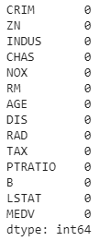
Data Pre-processing
After loading the data, it’s a good practice to see if there are any missing values in the data. We count the number of missing values for each feature using isnull()
boston.isnull().sum()
There are no missing values in this dataset as shown below
Computer Science & Engineering –20CS51I

Slide 10
Exploratory Data Analysis
Let’s first plot the distribution of the target variable MEDV. We will use the displot function from the seaborn library.
sns.set(rc={'figure.figsize':(11.7,8.27)})
sns.displot(boston['MEDV'], bins=30)
plt.show()
Computer Science & Engineering –20CS51I

Slide 11
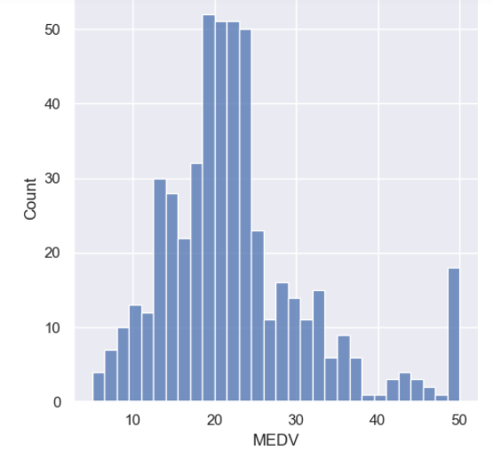
Exploratory Data Analysis
# output
Computer Science & Engineering –20CS51I

Slide 12
Exploratory Data Analysis
Create a correlation matrix that measures the linear relationships between the variables. The correlation matrix can be formed by using the corr function from the pandas dataframe library. We will use the heatmap function from the seaborn library to plot the correlation matrix.
correlation_matrix = boston.corr().round(2)
# annot = True to print the values inside the square
sns.heatmap(data=correlation_matrix, annot=True)
Computer Science & Engineering –20CS51I

Slide 13
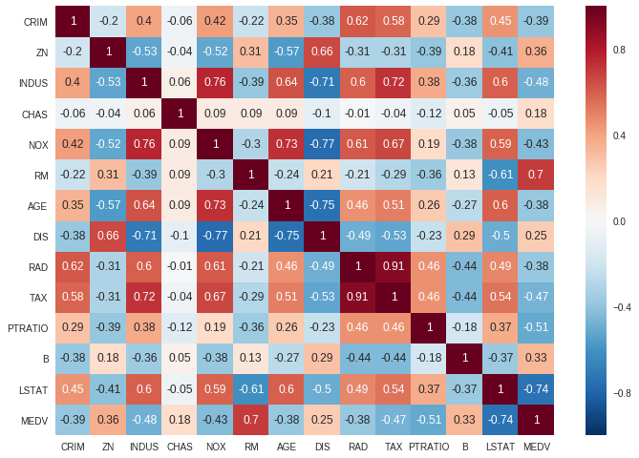
Exploratory Data Analysis
Computer Science & Engineering –20CS51I

Slide 14

Exploratory Data Analysis
Based on the observations we will understand RM and LSTAT as our features. Using a scatter plot let’s see how these features vary with MEDV
plt.figure(figsize=(20, 5))
features = ['LSTAT', 'RM']
target = boston['MEDV']
for i, col in enumerate(features):
plt.subplot(1, len(features) , i+1)
x = boston[col]
y = target
plt.scatter(x, y, marker='o')
plt.title(col)
plt.xlabel(col)
plt.ylabel('MEDV')
Computer Science & Engineering –20CS51I

Slide 15
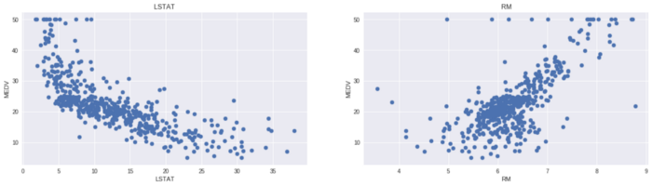
Exploratory Data Analysis
#output
Computer Science & Engineering –20CS51I

Slide 16

Preparing the Data for Training the Model
Concatenate the LSTAT and RM columns using np.c_ provided by the numpy library.
X = pd.DataFrame(np.c_[boston['LSTAT'], boston['RM']], columns = ['LSTAT','RM'])
Y = boston['MEDV']
Computer Science & Engineering –20CS51I

Slide 17
Splitting the data into training and testing sets
To split the data, we use train_test_split function provided by scikit-learn library. We finally print the sizes of our training and test set to verify if the splitting has occurred properly.
from sklearn.model_selection import train_test_split
X_train, X_test, Y_train, Y_test = train_test_split(X, Y, test_size = 0.2, random_state=5)
print(X_train.shape)
print(X_test.shape)
print(Y_train.shape)
print(Y_test.shape)
Computer Science & Engineering –20CS51I

Slide 18
Splitting the Data into Training and Testing Sets
#output
(404, 2)
(102, 2)
(404,)
(102,)
Computer Science & Engineering –20CS51I

Slide 19

Training and Testing the Model
Use scikit-learn’s Linear Regression to train our model on both the training and test sets.
from sklearn.linear_model import LinearRegression
from sklearn.metrics import mean_squared_error
lin_model = LinearRegression()
lin_model.fit(X_train, Y_train)
Computer Science & Engineering –20CS51I

Slide 20
Model Evaluation
Evaluate our model using RMSE and R2-score
# model evaluation for training set
y_train_predict = lin_model.predict(X_train)
rmse = (np.sqrt(mean_squared_error(Y_train, y_train_predict)))
r2 = r2_score(Y_train, y_train_predict)
print("The model performance for training set")
print("--------------------------------------")
print('RMSE is {}'.format(rmse))
print('R2 score is {}'.format(r2))
print("\n")
Computer Science & Engineering –20CS51I

Slide 21
Model Evaluation
# model evaluation for testing set
y_test_predict = lin_model.predict(X_test)
rmse = (np.sqrt(mean_squared_error(Y_test, y_test_predict)))
r2 = r2_score(Y_test, y_test_predict)
print("The model performance for testing set")
print("--------------------------------------")
print('RMSE is {}'.format(rmse))
print('R2 score is {}'.format(r2))
Computer Science & Engineering –20CS51I

Slide 22
Model Evaluation
The model performance for training set
--------------------------------------
RMSE is 5.6371293350711955
R2 score is 0.6300745149331701
The model performance for testing set
--------------------------------------
RMSE is 5.137400784702911
R2 score is 0.6628996975186952
Computer Science & Engineering –20CS51I

Slide 23
Conclusion
Machine is able to predict the value of prices of the house based on the given features.
Computer Science & Engineering –20CS51I

Slide 24

Thank You
Content Developers
BHAVANI H R | 119 Government Polytechnic for Women, Bangalore

